Slide 1

BizSTAMP
BizSTAMP
bizSTAMP
#swaccra
facebook.com/bizSTAMP
www.bizSTAMP.com
1

Slide 2


PROBLEM STATEMENT
2

Slide 3
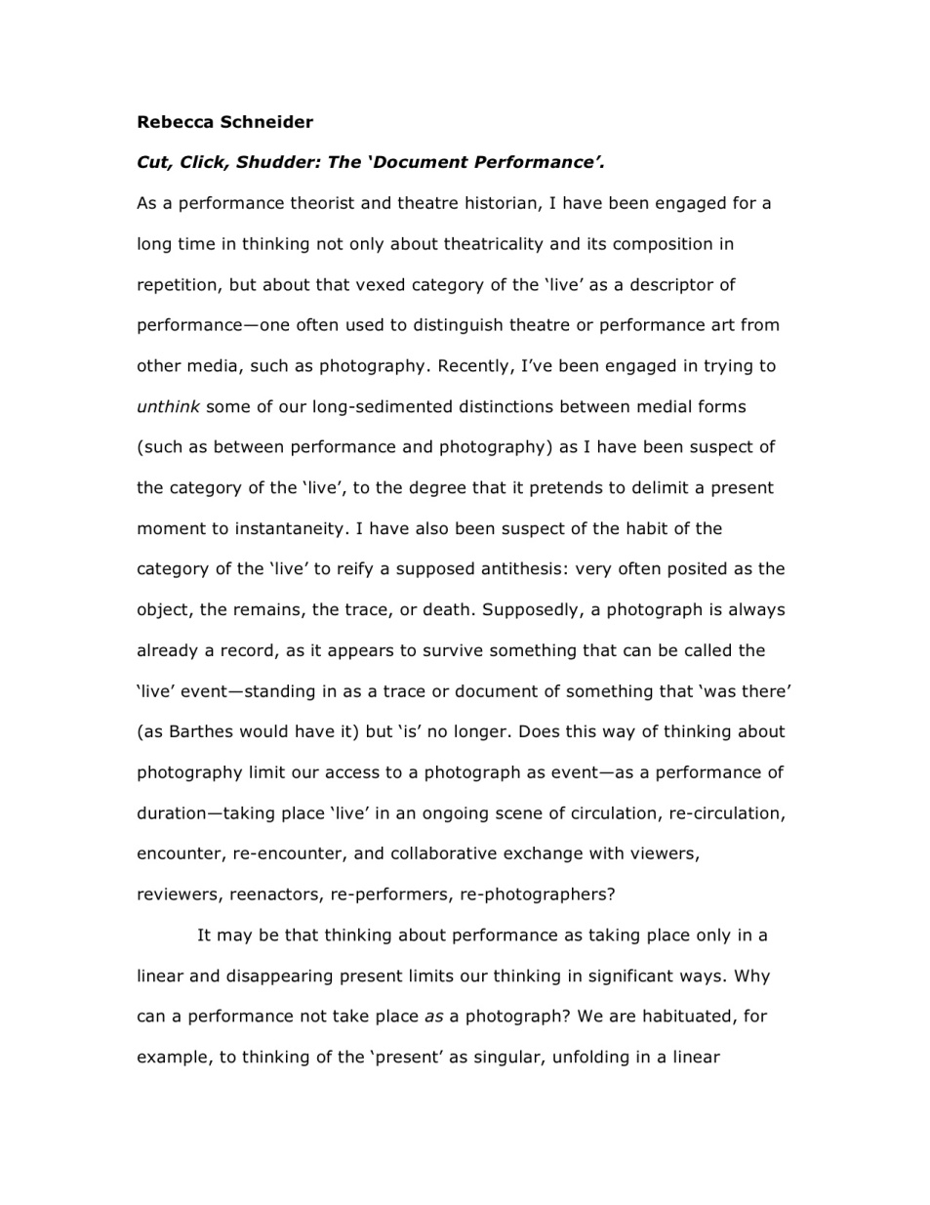
BizSTAMP
3

Slide 4
VALUE PROPOSITION
Confidence in the security of a document
It helps save time and effort.
Increase productivity
4

Slide 5
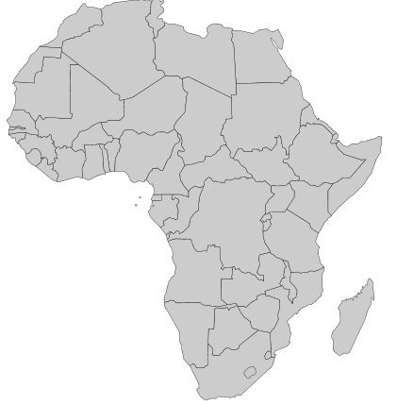
TARGET MARKET
TARGET MARKET
CHARACTERISTICS
AFRICA
HIGH STAMP USAGE
HIGH COMPUTER USAGE
ELECTRONIC DOCUMENT
INTERNET ACCESS
5

Slide 6
RESOURCES
PARTNERS
SERVERS
HUMAN RESOURCE
STARTUP CAPITAL
AMAZON
GOOGLE(GOOGLE
DOCS)
EMAIL SERVICES
6

Slide 7
ACTIVITIES
DISTRIBUTION CHANNEL
DEVELOPMENT COST
MARKETING
WEBSITE
MOBILE
7
Notes:
CUSTOMER AQUISIYION COST:
LIFE TIME VALUE OF A CUSTOMER:
7

Slide 8
REVENUE & PRICING MODEL
SUBSCRIPTION
PAY BY STAMP
$0.25 per stamp
8

Slide 9
TOTAL ADDRESSABLE MARKET
$150,000,000

Slide 10

COMPETITORS
10

Slide 11




GO TO MARKET STRATEGY
11

Slide 12




CUSTOMERS
12

Slide 13
BizSTAMP
THANK YOU
13

Slide 14
BreakDown
Government Institution:
100*5*4*12*0.5=GH¢12,000 = $6,000
57 companies
57*6000=$342,000
25 African countries *342,000 = $8,550,000
Banks, Schools, Companies.
1000*100*5*4*12*0.5 = GH¢12,000,000 = $6,000,000
25*6,000,000= 150,000,000
150,000,000 +8,550,000 =$158,550,000
14

